Slide 1

Hotel Rating Classification
GROUP - 2:
Dipali Sagar Vidhate
Tushar Vispute
Rahul
Madhusmita Pany
Sourav Manav Manik
Raghvendra Pratap Singh
Saikiran Dasari

Slide 2
Business Objective
To examine how travelers are communicating their positive and negative experiences on online platforms for staying in a specific hotel.
To find the attributes that travelers are considering while selecting a hotel.
To understand which elements of their hotel influence more in forming a positive review.
To help hotel manager to understand which elements of their hotel influence more in forming a positive review or improves hotel brand image.

Slide 3

Exploratory Data Analysis

Slide 4
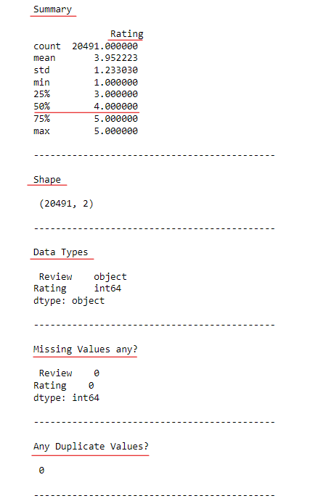
Descriptive Statistics:
Data contents – Reviews & Rating.
Data Size – 20491 Rows & 2 Columns.
Data Type – Object & Float.
Source – Online platforms
Bullet Point:
On an Average the Overall Rating is 4

Slide 5
Dataset Information
The Dataset contains hotel reviews and ratings given by travelers.
Ratings are given on the scale of 1 to 5, Where 5 is the highest and 1 is the least rating.
There are no duplicates in the dataset.
There are no missing values in the dataset.
With this dataset, consisting of 20k reviews, we can explore what makes a great hotel and drawbacks.

Slide 6
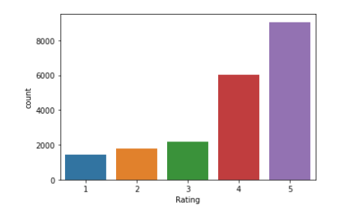
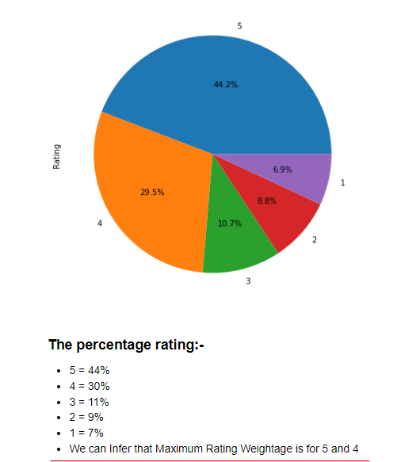
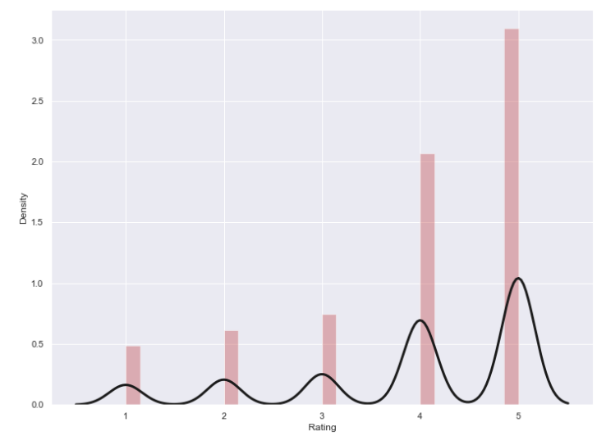
Rating Visualizations and its Distributions with Bullet point

Slide 7
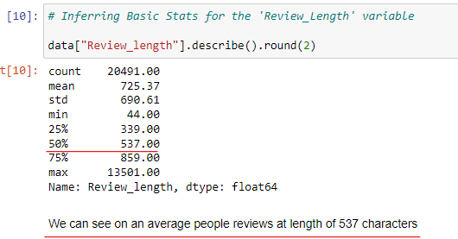
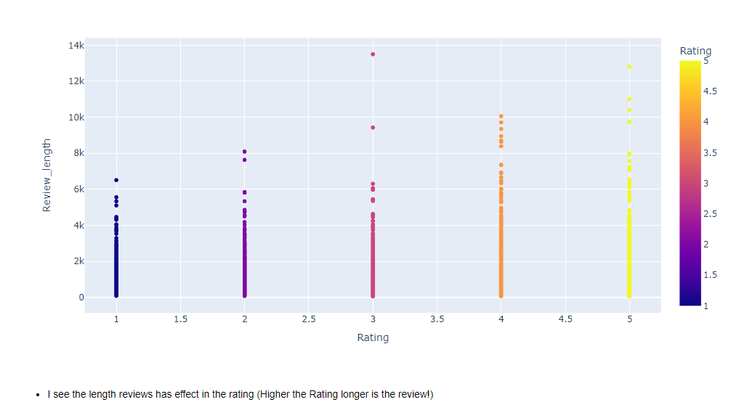
Relationship between length of the Review vs rating Value
A line plot between Rating & Review length to see if there is any co-relation between them.
Positive correlation can be seen in the plotted graph.

Slide 8
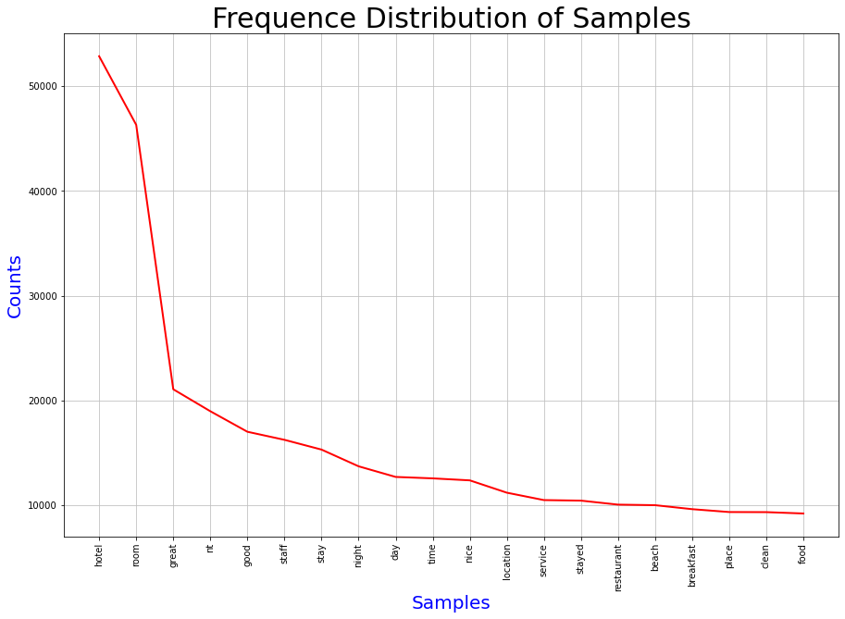
Data Cleaning and visualizations
In this Stage, we text-pre-processed the data by Lowering each words, Removal of: Line breaks, Punctuations, Stop-words, Numbers and Lemmatizing text.
# There are total 2001084 tokens are filtered and Unique samples are 71422.
In this Plot we can see top 20 Highest to lowest terms used in Dataset
Hotel, room, great, good, staff, stay, night, day etc

Slide 9
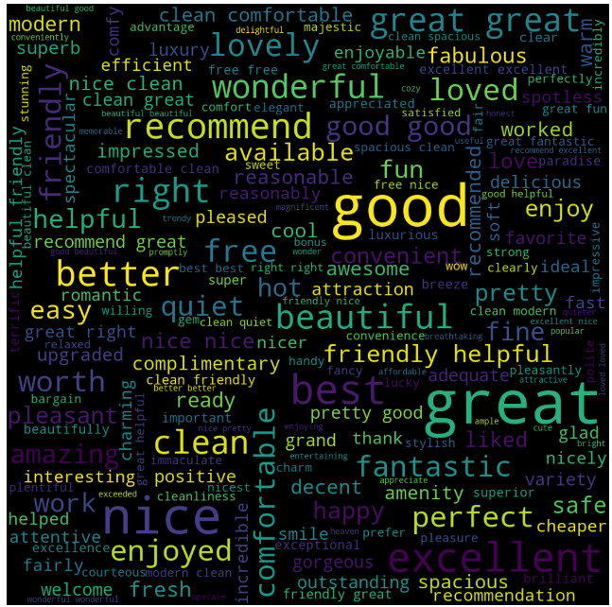
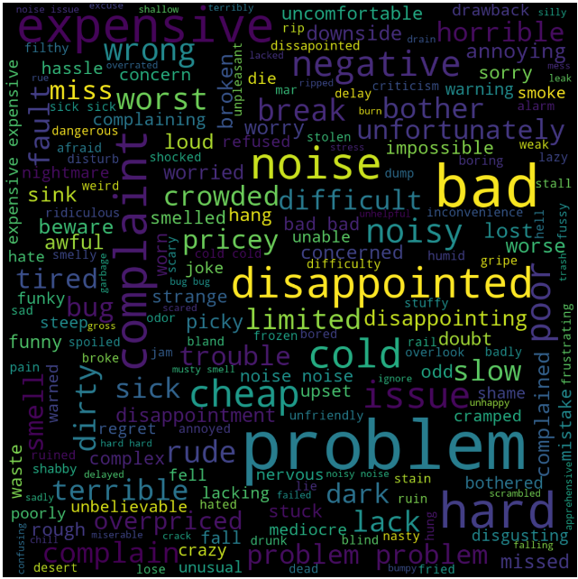
Word Cloud Visualizations: Positive Word cloud Negative Word cloud
This answers the Business Objective of identifying the elements of hotel which influence more in forming a positive review or improves hotel brand image.
Most of the words are indeed related to the customer experience with the hotel stay: great, good, nice, perfect, loved, enjoyed, friendly, comfortable etc.
Some words are more related to hotels: room, amenity, clean, staff, etc
Words are indeed related to the customer experience with the hotel stay: Problem, bad, noise, disappointed, worst etc.
Some words are more related to hotels: expensive, smell, cold, dirty, noisy, rude.

Slide 10
FEATURE ENGINEERING & Sentiment Analysis

Slide 11
Analysis: Rating
Positive: Rating above 3
Neutral: Rating equal to 3
Negative: Rating below 3
Here, the analysis is done based on the ratings given by the travelers to the hotel. Where reviews are categorized in Positive, Neutral & Negative.

Slide 12
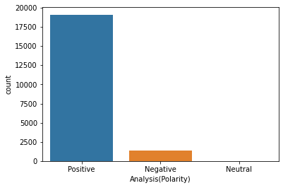
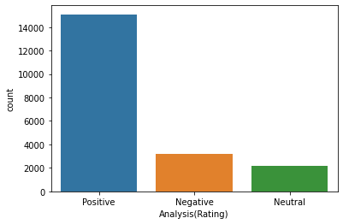
Text-blob Analysis vs Rating Analysis
More reviews are categorized in the positive category in Text-Blob analysis.
It has put almost zero reviews in neutral category.
Analysis done with the Text-Blob has put lesser number of reviews in the negative category.
Lesser reviews are categorized in the positive category in analysis done by the ratings.
There are some reviews in neutral category too.
Analysis done by the ratings has more number of reviews in the negative category.

Slide 13
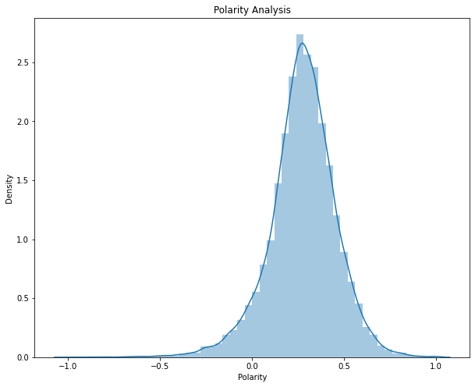
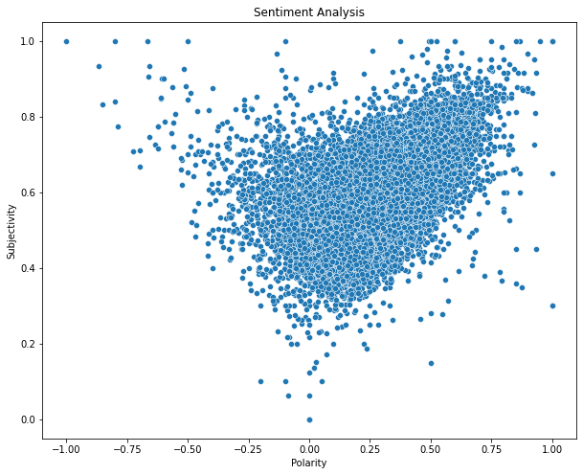
Polarity & Subjectivity
Through the above graph it can be interpret that most of the travelers have shared their personal experience. As most of the reviews are on the higher side of the subjectivity.
It can be inferred from the density plot that most of the reviews are on the positive side of the polarity

Slide 14
Interpretations
People consider the following attributes while choosing a hotel stay:
Hotel Environment/Amenity
Hotel Location
Hotel Room size
Food
Service
Hotel Staff
This answers the Business Objective of identifying the elements of hotel which influence more in forming a positive review or improves hotel brand image

Slide 15
VADER Sentiment Analysis
VADER (Valence Aware Dictionary and sEntiment Reasoner) is a lexicon and rule-based sentiment analysis tool that is specifically attuned to sentiments expressed in social media. VADER uses a combination of A sentiment lexicon is a list of lexical features (e.g., words) which are generally labeled according to their semantic orientation as either positive or negative. VADER not only tells about the Positive and Negative score but also tells us about how positive or negative a sentiment is.(VADER sentiment analysis returns a sentiment score in the range -1 to 1, from most negative to most positive. )

Slide 16
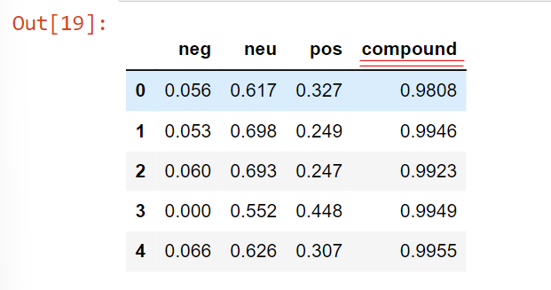
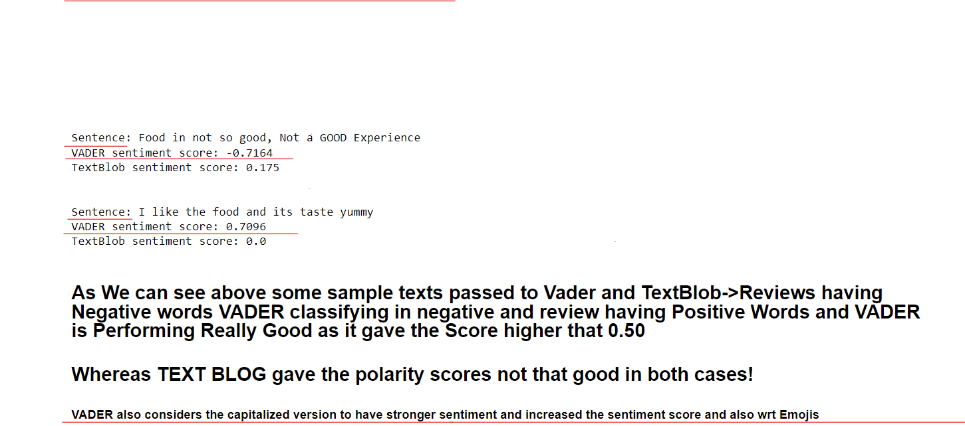
The Extracted result after Performing Vader Analysis

Slide 17
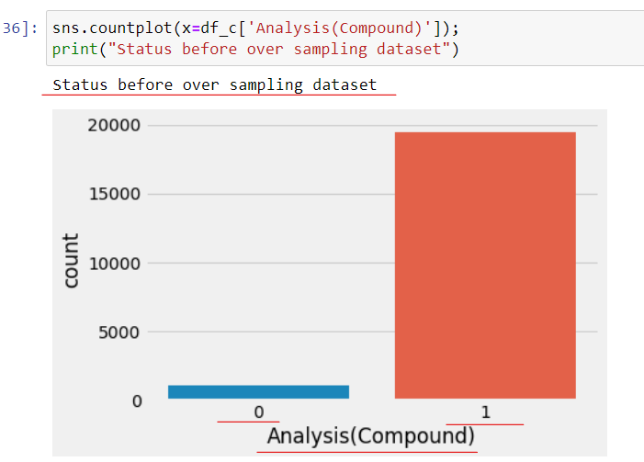
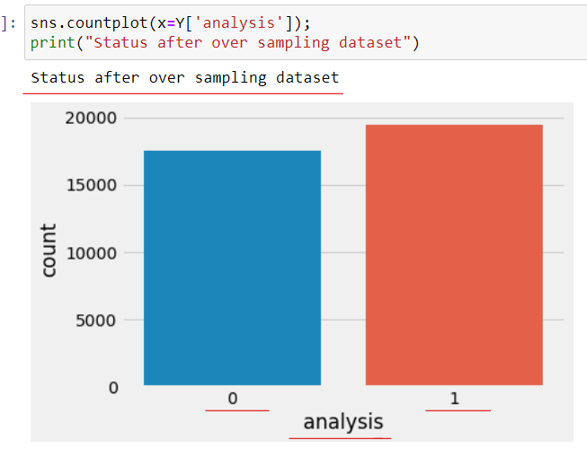
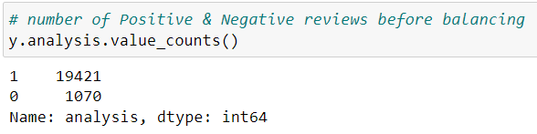
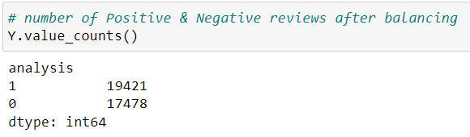
The Dataset in Very Imbalanced! Tried Balancing using “Random Over Sampler”

Slide 18
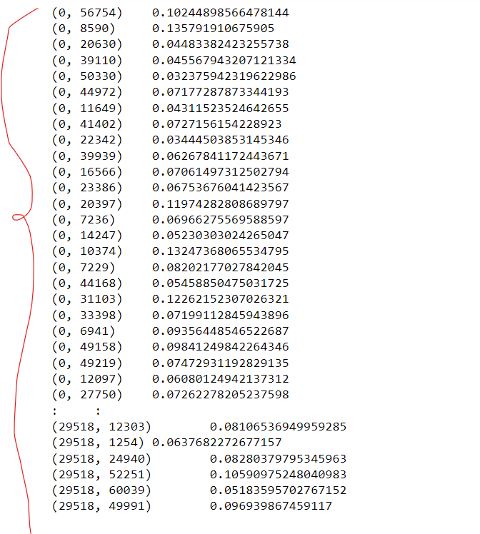
Term Frequency Inverse Document Frequency (TF-IDF) to Convert the Review Texts{Stings} to Numbers{float} for Model Building!
The TF-IDF approach follows a weight scheme based on high/Low frequency of words from on text corpus
(It’s a 2 factor Component , first we have to compute TF and secondly compute IDF
and multiply both we will get Weights of that particular word)
TF(w) = No. of times the word w occurs in a document/Total no. of words in the document
IDF(w) = log(Total no. of documents / No. of documents containing word w)
Weight(w,d) = TF(w,d) * IDF(w)

Slide 19
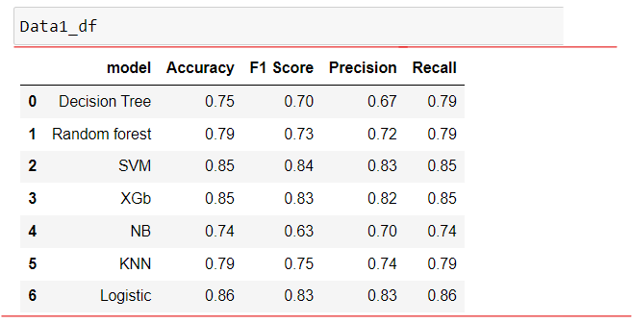
MODEL Building! Various Classification Models have been Build and Inferred the Accuracy Score, F1-Score, Precision, Recall

Slide 20
DEPLOYMENT
Final Model:
SVM – Support Vector Machines
Accuracy : 0.85
F1 Score : 0.84
Precision : 0.83
Recall : 0.85

Slide 21
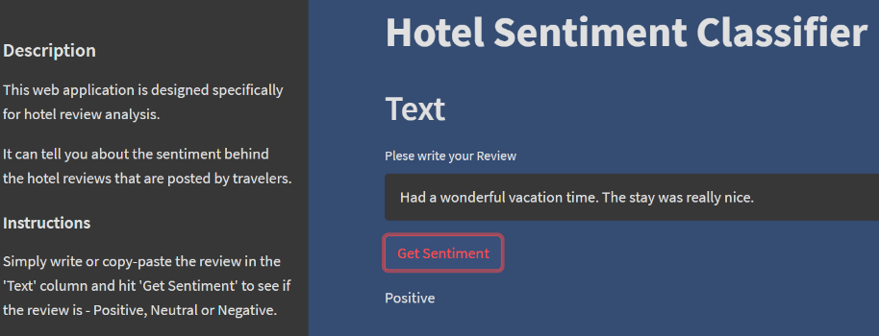
MODEL DEPLOYMENT USING STREAMLIT

Slide 22
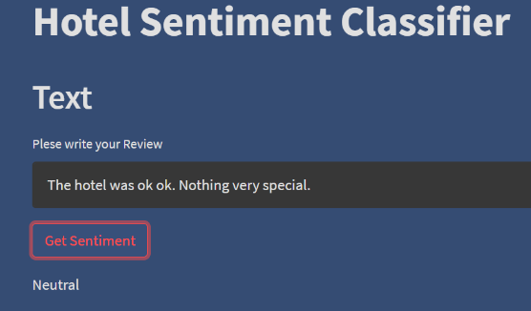
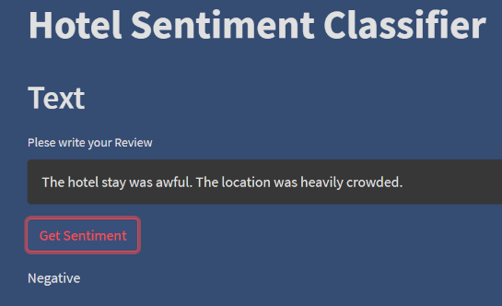
MODEL DEPLOYMENT USING STREAMLIT

Slide 23

Thank You!

